Slide 1
HYDROGEN FUEL CELLS
&
ENERGY EFFICIENCY
By:
Claudio Bolzoni
David Carlos Echeverria
Andres Segura
Dari Seo

Slide 2
FUEL CELLS
Definition: electrochemical cell that converts a source fuel into an electrical current.
The fuel cell generates electricity through reactions between a fuel and an oxidant.

Slide 3
Hydrogen Fuel Cells
A hydrogen fuel cell uses hydrogen as its fuel and oxygen as its oxidant.
Its very similar to a battery but it has its differences.
Discovered by Christian Firedrich Schönbien in 1838

Slide 4
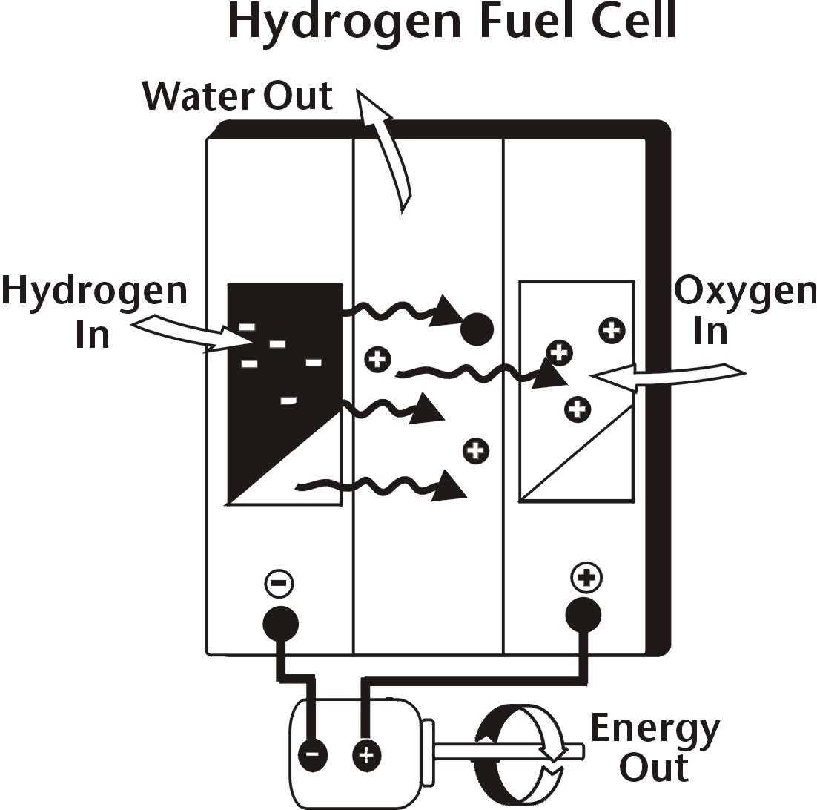

Slide 5



Benefits
Reduction in burning of fuel cells
Improvement of air quality especially in urban areas
Reduction of greenhouse gases (global warming)
Low noise and high power
Reduction in energy consumption (saving energy)

Slide 6

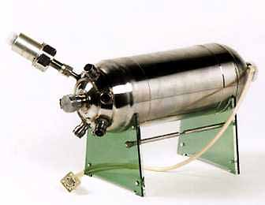


Problems
Cost
Durability
Hydration
Delivery
Infrastructure
Storage
Safety

Slide 7
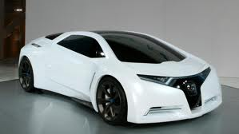
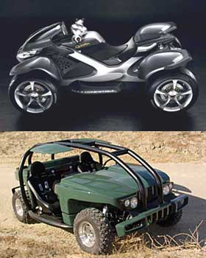


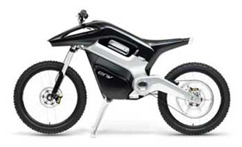
Examples
Vehicles
Bicycles
Rockets
Airplanes
Buses
Motorcycles
Scooters

Slide 8
Hydrogen Automobile
An alternative fuel vehicle which uses hydrogen as its fuel.
Chemical energy in hydrogen is converted into mechanical energy.
Funding comes from both private and government sources.
Cost around $400,000.
"It's still a ways away from commercialization"

Slide 9
BENEFITS
Reduce greenhouse gases
Reduce dependency on oil
Technological development
PROBLEMS
Expensive
Needs hydrogen gas stations
"A hydrogen car is one of the least efficient, most expensive ways to reduce greenhouse gases.“ U.S Department

Slide 10
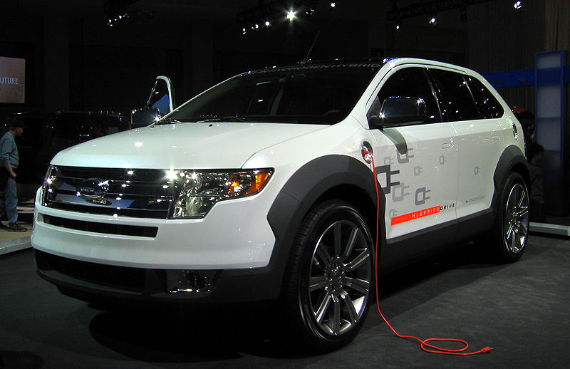
Ford edge hybrid-2007

Slide 11

The Evolution, General Motors

Slide 12
Hydrogen Rocket
BENEFITS
Highest effective exhaust velocity
Lower weight
Velocity change (lift off weight is less)
Works well in upper stages
PROBLEMS
Low density, needs insulation (weight)

Slide 13

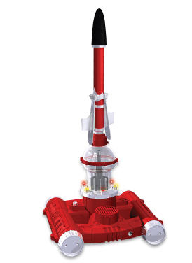

Slide 14
Efficiency
Dependent on the amount of power drawn from the fuel cell
For a hydrogen cell operating at standard conditions with no reactant leaks, the efficiency is equal to the cell voltage divided by 1.48 V, based on the reaction.
The more current drawn, the lower the efficiency
The efficiency of a cell is almost proportional to its voltage.
Do not operate in thermal cycle

Slide 15
Video Link
www.auto.howstuffworks.com/fuel-efficiency/alternative-fuels/fuel-cell.html

